Slide 1
DSA 210 Project
Furkan Emre Öztürk
00032084

Slide 2
Purpose
To find if there is a relationship with my step count and my exam dates
To find if my step count changes between weekends and weekdays

Slide 3
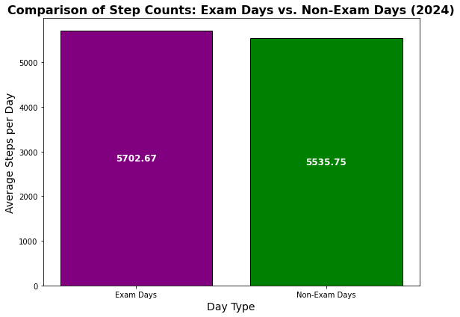
Average Step Count Graph Between Midterm Dates and Normal Days

Slide 4
Comments on the graph
We can see that my average step counts are too close too each other.
My average step count on exam days are a little bit more because after the exams I prefer to go outside.

Slide 5
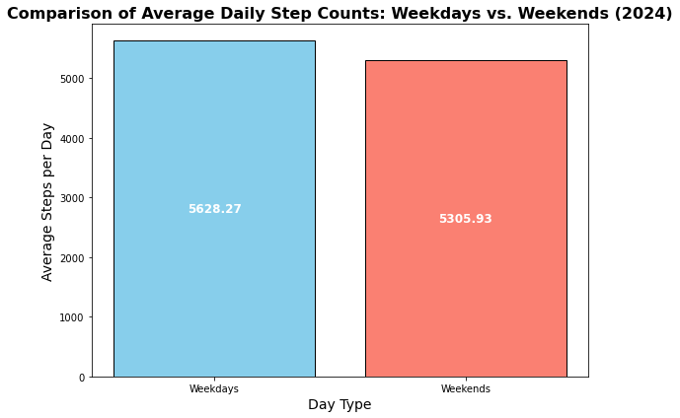
Average Step Cunts of Weekends and Weekdays

Slide 6
Comments on graph
Again, we can see that my average step counts are close to each other.
I was expecting a bigger difference
Maybe there is not a big difference because on weekdays I go to classes and sport center everyday. On the other hand, on weekends I don’t do that but I go outside to hang out with my friends etc.

Slide 7
Final
We couldn’t find a relationship between my step count and my exam dates.
We couldn’t find a difference between weekends and weekdays in case of my step count

